Slide 1
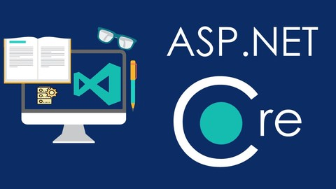
Introduction to ASP.NET Core (MVC)
SoftUni Team
Technical Trainers
Software University
http://softuni.bg

Slide 2
Table of Contents
Negotiation GitHub
ASP.NET Core Overview
ASP.NET Core MVC Overview
MVC
Database
User Identity

Slide 3

Recap GitHub

Slide 4
Questions
What is Git/GitHub and why are we using it?
What is commit and branch?
What is Kanban?
Bonus question: How are you adding a new person to you project?

Slide 5
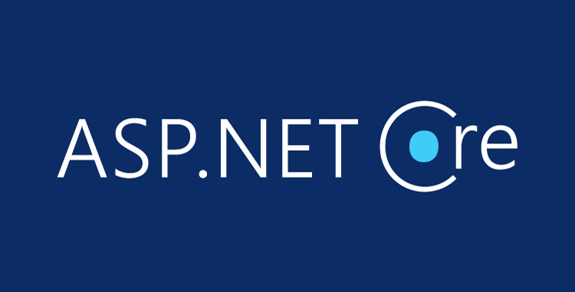
ASP.NET Core Overview

Slide 6
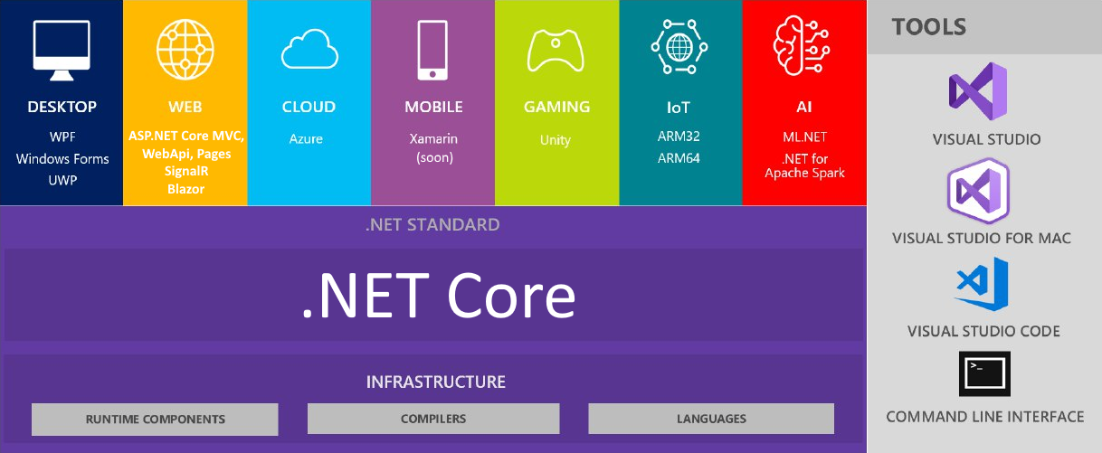
.NET Core: Bird's Eye View

Slide 7
ASP.NET Core Overview
ASP.NET Core is a cross-platform, open-source web framework
You can build web applications and services, IoT apps, mobile backends and any web-based solution with ASP.NET Core
It can be deployed to the cloud (e.g. Azure) or on-premises
Great documentation: https://docs.microsoft.com/en-us/aspnet
ASP.NET Core provides:
Integration of modern client-side frameworks (Angular, Blazor, etc.) and development workflows (MVC, WebAPI, Razor Pages, SignalR)
ASP.NET Core applications run both on .NET Core and .NET Framework

Slide 8
ASP.NET Core Main Features
A unified framework for building web UI and web APIs, architected for testability
Ability to develop and run on Windows, macOS, and Linux
Ability to host on IIS, Nginx, Apache, Docker, or self-host in your own process
Built-in dependency injection
A lightweight, high-performance, and modular HTTP request pipeline (middlewares)
Razor Pages is a page-based programming model that makes building web UI easier
Blazor lets you use C# in the browser and share server-side and client-side app logic
Razor markup provides syntax for Razor Pages, MVC views and Tag Helpers
Cloud-ready, environment-based configuration system
Side-by-side app versioning
Tooling that simplifies modern web development (Visual Studio, VS Code, CLI)

Slide 9
ASP.NET Core
MVC
Pages
WebAPI
SignalR
Blazor
WebForms, MVC, Web API
ASP.NET CORE
ASP.NET 4.6
.NET Core
.NET Framework

Slide 10
ASP.NET vs ASP.NET Core
ASP.NET is a mature framework (v1.0 released January 2002)
Provides the services needed to build enterprise-class, server-based web applications on Windows
ASP.NET MVC works only on Windows and only in IIS
Latest version: 5.2.5
ASP.NET Core is a relatively new open-source framework (v1.0 released June 2016)
Cross-platform framework
Suitable for building modern, cloud-based web applications on Windows, macOS, or Linux
Latest version: 3.0

Slide 11
ASP.NET vs ASP.NET Core (2)
ASP.NET MVC
One version per machine
System.Web.dll
Everything is included by default
HTTP Modules, HTTP Handlers, Global.asax
MVC + Web API + Web Pages
Child Actions (Html.Render)
Web.config
ASP.NET Core
Kestrel, Windows, Mac, Linux
Multiple versions per machine
Everything is Nuget packages
Middlewares. All-in-one. Faster.
JSON and environment variables
View Components, Tag Helpers
Build-in DI, logging, services, file providers, WebSockets

Slide 12
MVC
MVC

Slide 13

What is MVC
Design Pattern
Model – manages data and logic
View – presentation layer
Controller – converts the input data into commands and sends it to the View or to the model

Slide 14
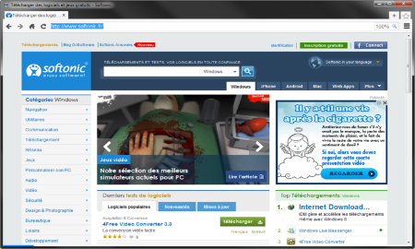



MVC
(Web) client
Request
Controller
Response
(html, json, xml), console
Update
Model
User
action
Sees
Update
view
Model
View
14

Slide 15
Architecture
Repository
Service
Controller
Database
View
Object/
Entities
Models/ DTO
Backend

Slide 16
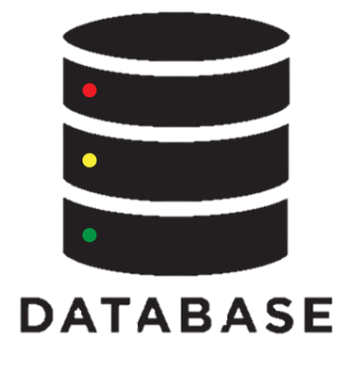
Database

Slide 17
What is database?
Organized collection of data
Relation database (SQL, MySQL, MSSQL, SQL Lite, Oracle…)
Nonrelation database (MongoDB, NoSQL)
Local/global store
Secure database

Slide 18
SQL
SQL Injection
SELECT * FROM Users WHERE UserId = 105; DROP TABLE Suppliers;
Entity Framework
Connection string
Contest
Create new table
Add-migration and Update-database

Slide 19

ASP.NET Core Identity System
Overview

Slide 20

ASP.NET Identity
The ASP.NET Core Identity system
Authentication and authorization system for ASP.NET Core Web apps
Supports ASP.NET Core MVC, Web API, SignalR, Blazor
Handles Users, User Profiles, Login / Logout, Roles, etc.
Keeps the user accounts in local DB or in external data store
Included via middleware:
app.UseAuthentication();

Slide 21

Summary
ASP.NET Core is a great platform for developing Web apps
Well-designed, Easily extensible, Highly testable
Has a large (and growing) community
Built from the ground up
But makes development easier for legacy ASP.NET developers
…
…
…

Slide 22
https://softuni.bg/trainings/courses

